Slide 1
The Importance of Being Inconsistent
Andreas Nielsen s174665, ​
Nikolas Vitaliti s223455, ​
Mathias Grønborg s194080
Notes:
Hello everybody, today I'll be the voice of the presentation, although all of us have contributed to the final version of it.
So: we have been assigned paper 5, which title you can see right here: The importance of being inconsistent.

Slide 2
Outline
Introduction​
Hartree-Fock DFT​
Kohn-Sham DFT​
Potentials​
Error Analysis​
Self Consistency & Inconsistency​
PDFT​
Binding Curves​
Conclusions
Notes:
Let’s start by going through a short outline of what we are going to see today:
The usual introduction will be given, and it will be followed by a recap on Hartree-Fock and Kohn sham DFT.
We will then move onto potentials showing you results for different approximations, which proves to you the significance of Error analysis.
After that is covered, we will move onto the core of the paper, where we will talk about the differences between Self consistency and Inconsistency.
And finally a brief explanation of PDFT along with a very important visual representation for it will be presented before giving some examples of physical phenomena where inconsistency calculations are relevant. Finally, our conclusions.

Slide 3
Introduction
In KS-DFT there exists a vast amount of Exchange-Correlation approximations
Error Analysis for a better future model approach
Normal vs. Abnormal systems
1.
Three most challenging concepts of ​
"The Importance of Being Inconsistent"
2.
3.
Notes:
Ok! So: The paper deals with different aspects, but we thought it would be great to mark the 3 most challenging ones to you before jumping into them.
First: In KS-DFT there exists a vast number of exchange-correlation approximations which is basically what fuels the discussion at hand
Then, we use Error Analysis for a better future model approach, by probing the weaknesses of the different approximations.
And lastly the differences between Normal vs. Abnormal systems which will hopefully be clearer by the end of the presentation

Slide 4
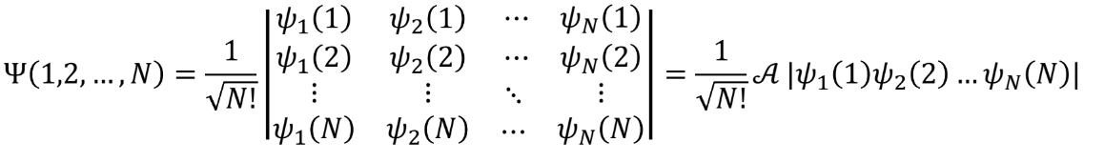
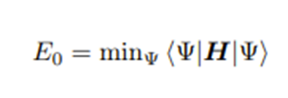
Hartree-Fock DFT
Starting point for almost all other approximations as it remarkably reduces the complexity of the many-body wave function by the introduction of a Single Slater Determinant.​
Gives very accurate Energies at the cost of density accuracy
Notes:
Alright then! Let’s start with our good old friend: the Hartree-Fock method.
As you probably know this is used to approximate the very complex many-body wave function such that it is reduced to a Single Slater Determinant which you can see right here:
The structure represented is very intuitive as both rows and columns are fixed on either orbitals or electron positions, and the scale of the matrix is determined by the number of orbitals we are considering. The slater determinant also helps us keep the antisymmetric property of the wave function; however, a normalization factor is introduced as the normalization is lost throughout the process.
In this way we can find the ground state energy by minimizing the Hamiltonian of the system
However, since Hartree-Fock method doesn't take electron correlation into account, other approaches have been developed, one such approach is the Kohm-Sham method that includes electron correlation but suffers self-interaction effects.

Slide 5
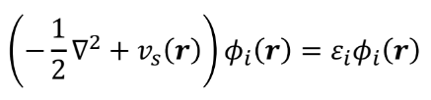
Kohn-Sham DFT
The KS approach to DFT calculations has become very popular with more than 30.000 scientific papers published each year [1].​
Proposes a Non-Interactive System that replicates the same density as the original one through the effective potential.​
Gives fairly precise densities.
Kinetic energy operator
Effective potential
Wave function (depends on density)
[1] Aurora Pribram-Jones, David A. Gross, and Kieron Burke. Dft: A theory full of holes? Annu. Rev. Phys. Chem., 66(1):283–304, 2015.
Notes:
Such an approach to standard DFT calculations is now one of the most popular and most used methods with more than 30.000 scientific papers published each year.
Kohn-Sham DFT Proposes a Non-Interactive System that replicates the same density as the original one using the effective potential: which basically means that starting from our original interacting system we simplify it by removing all the electron interactions and, hence reducing its complexity.
The strongest tool we have for such an approximation is the KS equation which we should all know. (Show equation) in which we can denote the different contributions, namely:
The Kinetic Energy operator; the Effective potential - which as we mentioned is the key to obtaining the same density as the one, we have in the original system-, and finally the wave function which, let’s not forget, depends on density too.
Now that we have established that there is a relation between the wave function and the potential in KS-DFT we can look further into that.

Slide 6
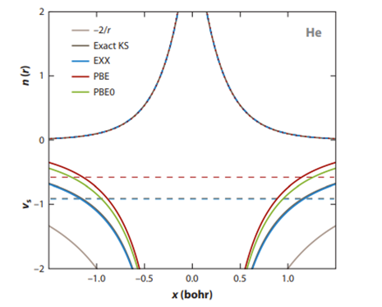
Potentials
Potentials miss the shell structure with corresponding oscillating errors in densities [2]
Quantification tool for the approximations is needed
[2] Lucian A. Constantin, John C. Snyder, John P. Perdew, and Kieron Burke. Communication: Ionization potentials in the limit of large atomic number. J. Chem. Phys., 133(24):241103, 2010.
Notes:
From this figure we can see the potential of various KS-DFT calculations with different exchange-correlation approximations. This evidently shows that all these approximations give different results.
Thereby missing the shell structure. This is due to an oscillation error for the densities, which implies that we need a quantification tool to adjust the error.
And it’s now time to move onto Error analysis to take a closer look on the driven error.

Slide 7
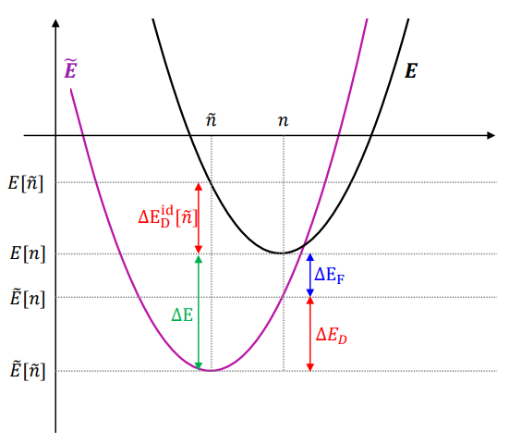
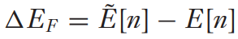
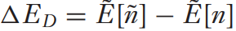

Error Analysis (Quantification tool)
Energy driven error:
Density driven error:
Total energy error:
Sim E, Song S, Burke K. Quantifying Density Errors in DFT. J Phys Chem Lett. 2018 Nov 15;9(22):6385-6392. doi: 10.1021/acs.jpclett.8b02855. Epub 2018 Oct 25. PMID: 30335392.
Notes:
As already mentioned early on, error analysis is one of the primary tools used to quantify errors of the different approximations used. We will now briefly go through the equations before giving a better visual representation and understanding for them. So just bear with us for a moment.
First, we make a distinction between the two main types of errors: the Energy driven error: which is the error defined as delta Ef (where the f stands as functional) in which the density stays fixed, and the error is calculated from approximated Energy and exact energy.
And then we have the density driven error which is instead defined as the difference in approximate and exact density by keeping the approximate energy fixed
In such a way we can define the total energy error as the sum of these two contributions.
Now, don’t you mind the graph, as our aim is to explain it to you step-by-step by other means: which brings you to our next exciting slide

Slide 8

Drawing Time!
Notes:
Now I ask you to pay close attention to this as it will be crucial for the understanding of the topic at hand. Drawing time!

Slide 9
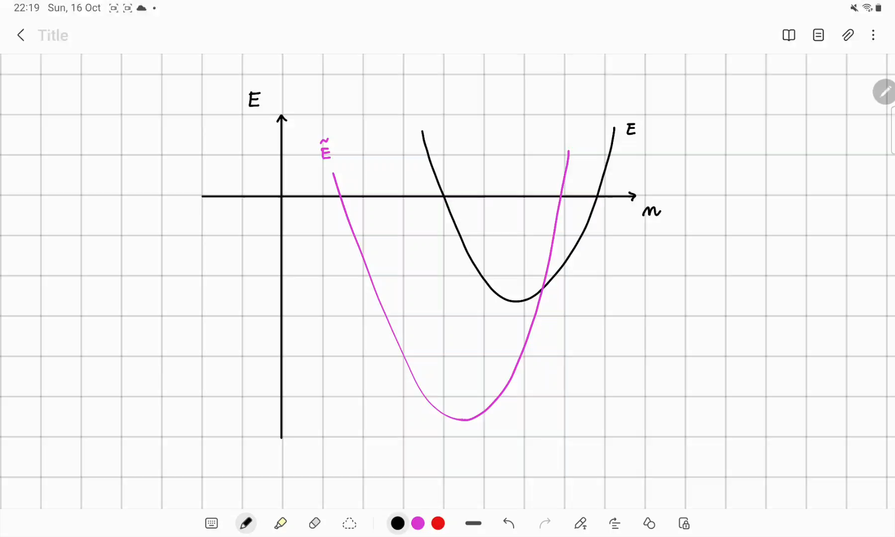
Notes:
ALLA FINE DELLA SLIDE: And now a final remark goes to the fact that since the energy error of any approximate self-consistent DFT calculation, can be decomposed in this manner, we can then classify these two into normal and abnormal

Slide 10
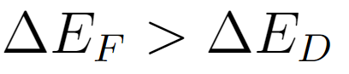
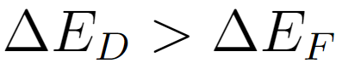
Importance of Error Analysis
Inconsistency
Self-Consistency
Notes:
A DFT calculation is called normal if, for the system of interest the energy driven error is greater than the density driven error.
Keep in mind that the vast majority of present DFT calculations meet this criterion, so for these ones self-consistency is used.
For a DFT calculation to be called abnormal instead, the density driven error is greater than the energy driven error. So, for these one's inconsistency is used instead.
To recap, for normal and abnormal calculation, we respectively consider self-consistency and inconsistency

Slide 11
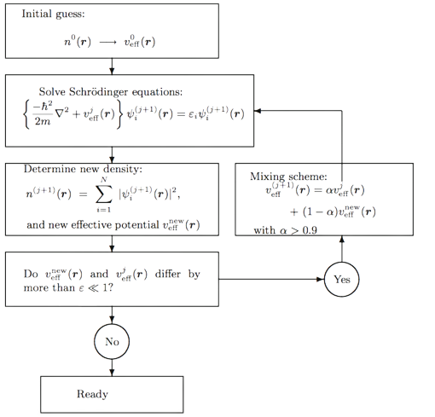
Self-consistency
Previous knowledge
SFC Loop
Inconsistency
Notes:
In DFT, calculations are done iteratively to gain energy from densities. As you surely remember from lecture 2.4.
The reason why we call these self-consistent is that the process is biased toward the initial guess which is typically based on prior knowledge. You can view it as sort of a constraint in terms of the likelihood for the calculations to find 'unexpected’ results.
Most of the time that’s good enough, however what should we ever do if it’s not?

Slide 12

Oh no! What are we going to do now?
We have no way of making up for the density driven error!
..Unless.. WAIT! There’s someone coming!

Slide 13
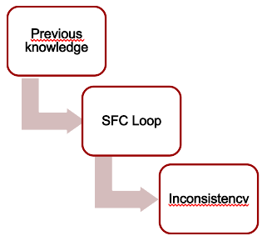

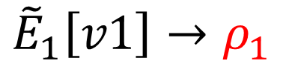
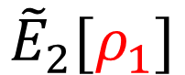
Inconsistency
Identify the weakness of your model (either strong energy- or density- driven error modelling)​
Optimize prior model weakness (use another model that has the strength of prior model weakness)​
Use it as input for a better and more precise result on a second model
SFC Loop
Inconsistency
Inconsistency
$${\tilde{E}}_{1}\left[v1\right]→ρ_{1}$$
$${\tilde{E}}_{2}[ρ_{1}]$$
Notes:
But on a serious note: by establishing a tool for error analysis, we can identify our model weaknesses.
Infact, just a few moments ago we went through this image without knowing the meaning of the final block, so let’s take a closer look at it.
To add inconsistency to our model we look for an optimal density through a self-consistent calculation. Such density is later used in a different ‘inconsistent’ model that has the opposite properties in terms of energy/density driven errors with respect to the original one.
The newly calculated energy from the inconsistent model can then be fed back to the Self Consistent Loop in order to further decrease errors.

Slide 14
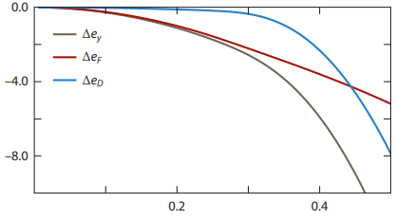
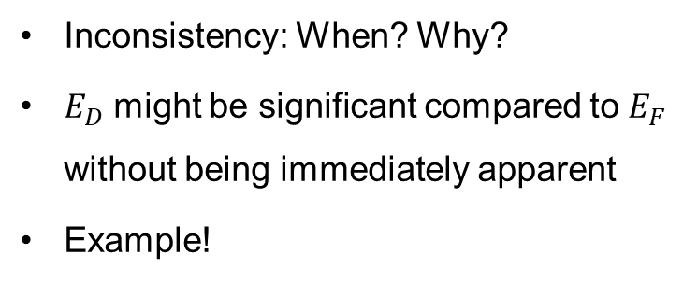
Abnormal vs normal systems
Inconsistency: When? Why?
$E_{D}$ might be significant compared to $E_{F}$ without being immediately apparent
Example!
Notes:
Well now, you might be asking yourself why some systems need inconsistent calculations and others do not.
The answer relies on the fact that the density driven error might be significant compared to the functional error without being immediately apparent. This is an abnormal system that needs inconsistent calculations.
An example of this is when the density driven error is an exponential function while the energy driven error is a linear functional which is sort of what you see in the image to the right. Here the density driven error has low significance until a certain point while the energy driven error is dominant.

Slide 15
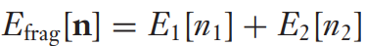
Partition density functional theory
Proposes a way to partition, or fragment, the system into smaller pieces.
Allows for easier calculations: possible minimization of the single fragments instead of the total energy.
Fragments driven error = energy driven error
Inconsistency applicable to each part of the system
Notes:
Now, another solution around the problem is proposed in the article: Partition density functional goes well together with HF-calculations. But before we go into the details as to why that is, we’ll just talk a little bit about what PDFT is.
PDFT is a method that partitions or fragments, the system into smaller pieces. This allows for easy calculations. We can add inconsistency along with a Kohn-sham approach to each single fragment created, which opens the possibility for high precision DFT work.

Slide 16
Visual representation of PDFT
HF-METHOD
PDFT
Many-body wave function
Potentialsand
Densities
Notes:
We will now show you a visual representation of the PDFT method:
Which shows how we can partition either the potential or the density into smaller fragments, which as we said allows for easier calculations

Slide 17
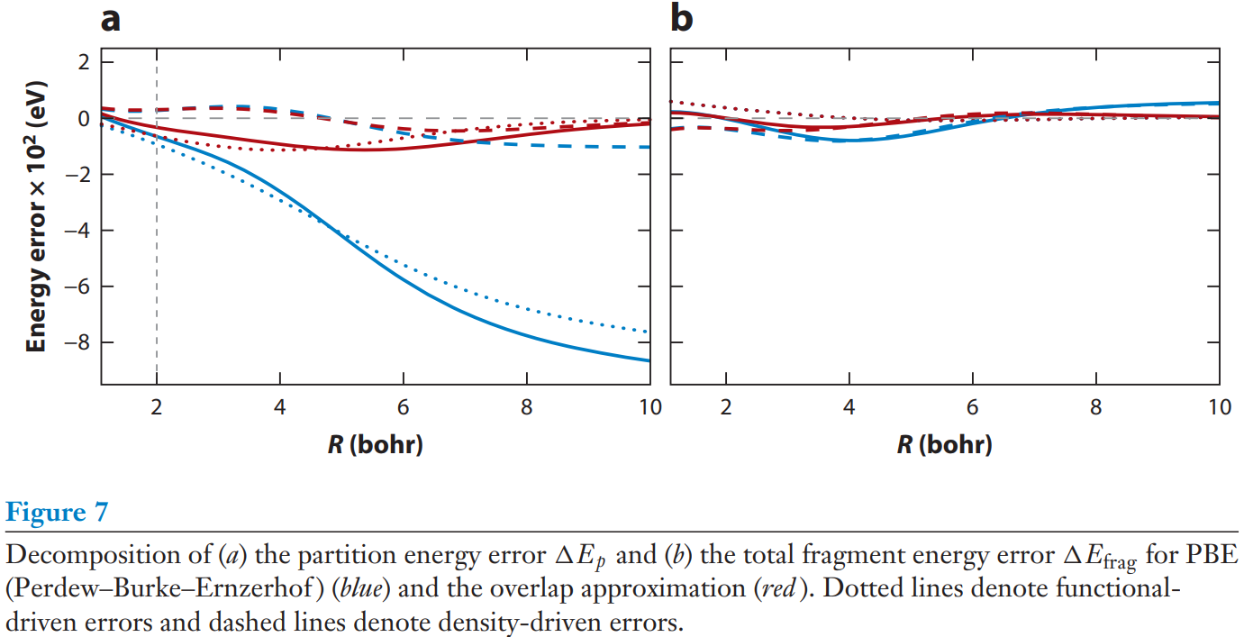
Notes:
Anyway, following up on our discussion, Figure A shows the decomposition of the partition energy error and figure B shows the total fragment energy error for PBE which is just another type of PDFT, where the overlap approximation is the red solid line.
Dotted lines denote instead functional-driven errors, and dashed lines denote density-driven errors. It shows that for Bohr radius>5 the density-driven error comes to dominate even the overlap approximation and thus HF-density can be used to improve it.
In figure B the fragment error is generally much smaller for PDFT.
And at Bohr radius>4, these errors are density-driven and can be again reduced by HF-DFT.

Slide 18
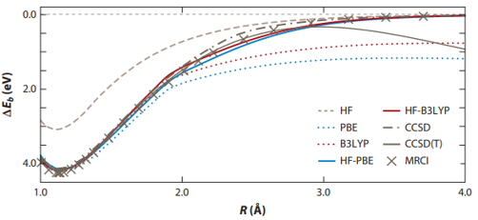
Binding Curves​
Incorrect dissociation starting after very short distances
HF-PBE yields similar results as higher ranks model (MRCI, CCSD(T), etc..)
Notes:
An example of a physical phenomenon where large density-driven errors often occur is binding curves. This is because Self-consistent DFT yields incorrect dissociation limits and deviates a lot at only 2 Å.
It is immediately evident from the figure that you need either a high-rank model or inconsistency calculations in order to reach acceptable binding curves.
For instance, HF-PBE and HF-B3LYP work just fine meanwhile B3LYP or PBE alone yield poor results. So generally, HF-DFT works extremely well in pairs with various high-rank models, as well as in producing the correct dissociation products for most approximate functionals.
Just for the sake of completeness we would just like to mention that an additional physical phenomenon where inconsistency calculations are useful is when calculating Electron Affinities.

Slide 19
Conclusions
Kohn-Sham approach to DFT is popular and needs careful attention in order to increase the accuracy of the potentials.​
Error analysis is an improvement to KS-DFT models for abnormal systems.​
In many cases one can get better results by using the HF density as input to a KS-DFT evaluation of the energy, as opposed to using the KS-DFT to generate a self-consistent density. This has been termed density driven error, as opposed to functional-error. ​
PDFT along with HF-DFT can reach very good results as the former deals with density driven errors while the latter deals with fragment driven errors.​
Inconsistency is very useful for Electron affinity and binding curve calculations.
Thanks inconsistency girl <3
Notes:
In conclusion: It was established in the beginning of the presentation that Kohn-Sham approach to DFT is popular and needs careful attention in order to increase the accuracy of the potential due to the various exchange-correlation approximations.
Subsequently, we moved into error analysis where we saw the need for adjustment to the methods used in DFT in case of abnormal systems and we thus elaborated on the inconsistency method.
Ultimately, the result of the paper is that in many cases one can get better results by using the HF density as input to a KS-DFT evaluation of the energy, as opposed to using the KS-DFT to generate a self-consistent density.
An example emphasized in the article was the combination of PDFT along with HF-DFT. This is due to the former being good at dealing with density driven errors while the latter is good at dealing with fragment driven errors.
And finally, we have seen that some physical phenomena where inconsistency is useful are Binding curve and Electron affinity calculations.
We really hope our efforts to make this presentation as informative and light as possible will reach you, and we thank you! (And inconsistency girl, we couldn’t have done it without her)

